Slide 1


DESIGN 1
Lesson 4: Review: Hyperlinks, Images & Tables Check
Ms. Abboud • Grade 9 - Design 1 • Term 1, Week 6

Slide 2
Learning Objectives
WALT - We Are Learning To
WILF - What I'm Looking For
Consolidate correct use of hyperlinks, navigation, and images together.
Submit evidence for the combined Week 5-6 formative.
Insert images successfully.
Apply image attributes correctly.
Improve webpage appearance.

Slide 3
Frayer Model: Source (src) (Review)
DEFINITION
CHARACTERISTICS
The attribute on an <img> tag that tells the browser where to find the image file.
An attribute on <img>; holds the file path; required to show the image.
SOURCE (SRC)
EXAMPLES
NON-EXAMPLES
src="images/profile.jpg".
alt (describes the image); href (used for links).

Slide 4
National Identity Integration
UAE Landmarks and Tourism: a page that combines working navigation with well-chosen, well-described images is exactly what a tourism or heritage site needs to do well.

Slide 5
STARTER
Quick-Fire Vocabulary
href, src, alt, target - match each one to its job.
Hook • Engage & Ask
5 - 10 minutes

Slide 6
LESSON CORE
I Do: Peer Review Setup
Partners will check each other's site for working navigation AND correctly inserted images.
Whole-class troubleshooting of any recurring errors from either topic first.
Gradual Release of Responsibility
30 - 40 minutes
1 / 2

Slide 7
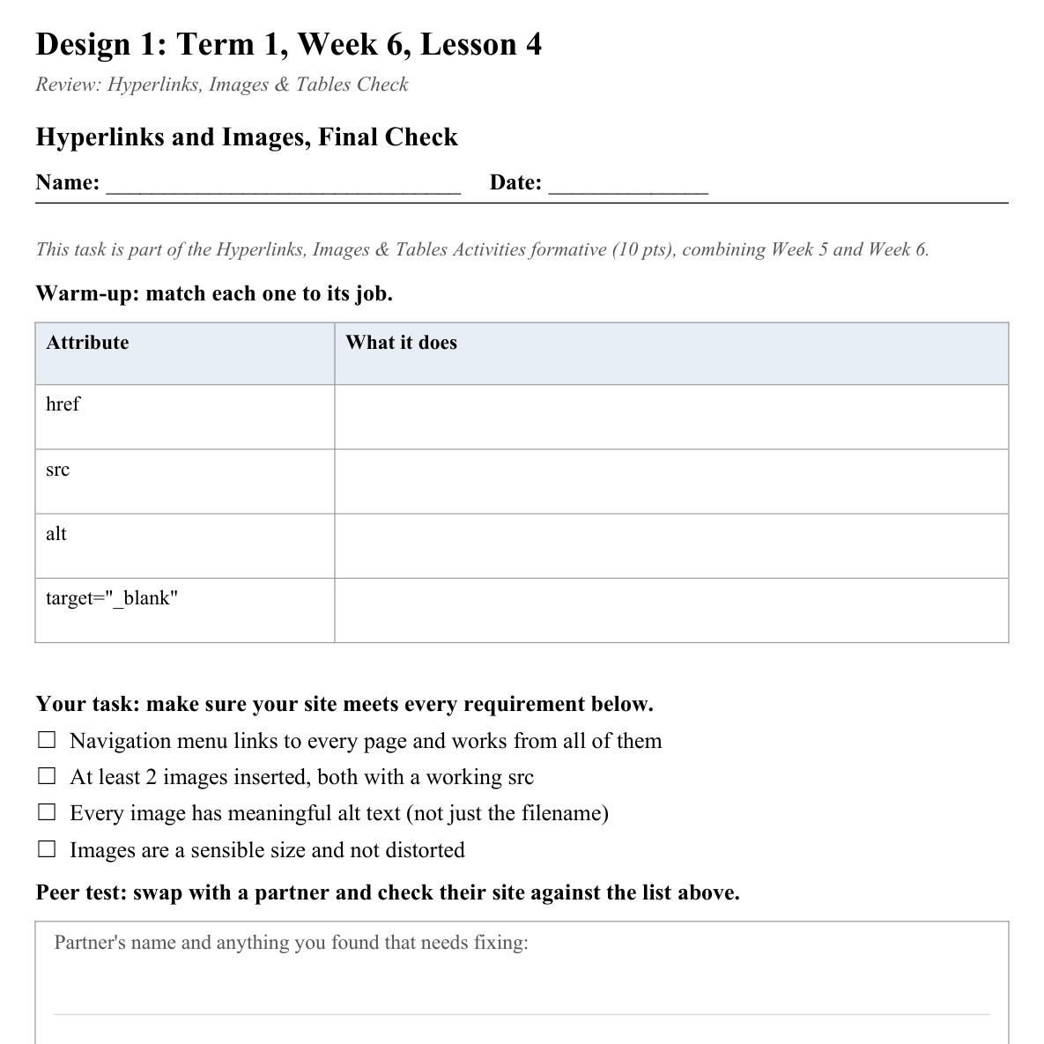
LESSON CORE
You Do: Review, Fix, Submit
Peer review your partner's site against the checklist, then finalize your own corrections.
Submit final evidence for the combined Hyperlinks, Images & Tables formative (10 pts).
Activity: Hyperlinks and Images, Final Check
Gradual Release of Responsibility
30 - 40 minutes
2 / 2

Slide 8
CLOSURE
Exit Ticket
One thing about your site you're proud of so far, one week before the mid-term break.
Transition & Extend
5 - 10 minutes

